Slide 1
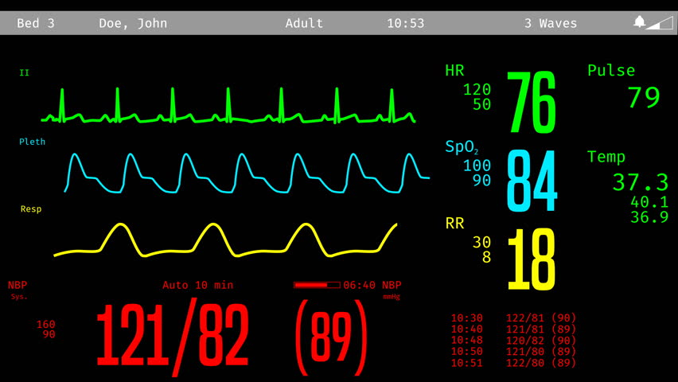
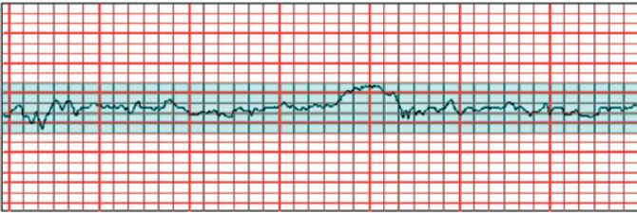

Simulation EVE
Initial state
FHR 140b/min
88
n
SPO2
98%
98.4
120/780

Slide 2

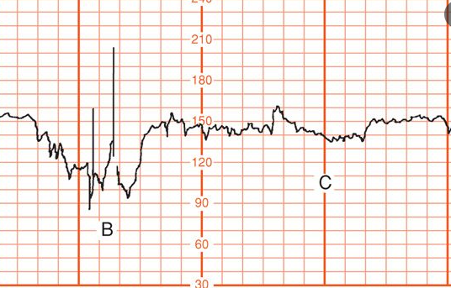
Simulation EVE
Crowning
100
n
SPO2
99%
98.0
24
122/800

Slide 3
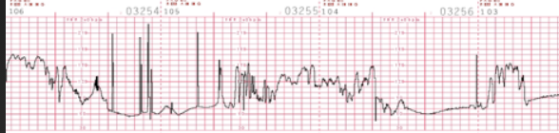
Simulation EVE
After Turtle sign
120
n
SPO2
98%
98.0
26
122/820

Slide 4
Simulation EVE
INITIAL STATE with severe features
90
n
SPO2
97%
98.4
24ft
166/1100

Slide 5
Simulation EVE
10 mins after first medication
90
n
SPO2
95%
98.0
24
170/1110

Slide 6
Simulation EVE
20 mins after 1st medication(Seizure)
110
n
SPO2
90%
98.0
14
184/1020

Slide 7
Simulation EVE
Post-ictal state
100
n
SPO2
94%
97.0
160/920

Slide 8
Simulation EVE
Stabilization
80
n
SPO2
98%
98.0
24
139/910

