Slide 1
Meaningful and Equitable Perinatal Toxicology Testing
Laurie Seidel Halmo, MD, FAAP
Assistant Professor of Pediatrics
University of Colorado School of Medicine
Volunteer Faculty, Rocky Mountain Poison and Drug Safety

Slide 2
Disclosures
None

Slide 3
Learning objectives
Define and distinguish screenings from confirmatory toxicology tests
Identify the limitations and nuances inherent in toxicology tests
Review and discuss the implications of documented inequitable toxicology testing practices, including bias and stigma, impact on care, and disparities in testing

Slide 4
What can tox testing tell you?
A tox test MIGHT tell you if a patient was exposed to a substance or a class of substances
A tox test WILL NOT tell you:
Who administered the drug
The route of administration
How much drug was administered
When the exposure occurred
Whether, and to what degree, a person was impaired/intoxicated
Whether a person was/is fit to parent or is a safe caregiver

Slide 5
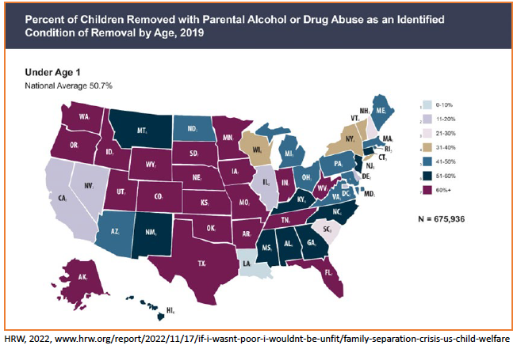
Thank you Mishka Terplan MD MPH for this slide

Slide 6
Confusing words
Screening:
Process of gathering information from patient about substance use
Use clinician-administered or self-administered validated tool
ALL PREGNANT AND BIRTHING PEOPLE should be screened for substance use
Testing:
Collection of a biological sample that assesses for the presence of a substance and/or its metabolite
A positive SCREEN does not always necessitate a toxicology TEST

Slide 7
Screening Tests vs. Confirmatory Tests
Screening tests:
Usually immunoassays
Usually qualitative
Riddled with false positives and false negatives
Inexpensive
Fast
Readily available
Confirmatory tests:
Usually HPLC, GC/MS or LC/MS (or similar)
Quantitative
Highly accurate and precise
Expensive
Slow
Usually requires “sending out”

Slide 8
Nuances of urine drug screening tests
What you find depends on what you look for and where you look for it
Cross reactivity is a major problem for immunoassays
There is a “threshold” or minimum amount necessary to make the test read “positive”

Slide 9
What you find depends on what you look for
Hospital 1:
Amphetamines
Benzodiazepines
Cocaine metabolites
Methadone
Opiates
Hospital 2:
Amphetamines
Barbiturates
Benzodiazepines
Cannabinoids
Cocaine metabolites
Ethanol
Opiates
Phencyclidine
Hospital 3:
Amphetamines
Barbiturates
Benzodiazepines
Cannabinoids
Cocaine metabolites
Methadone
Methamphetamine
Opiates
Oxycodone
Phencyclidine
Propoxyphene
Tricyclic antidepressants
Buprenorphine

Slide 10
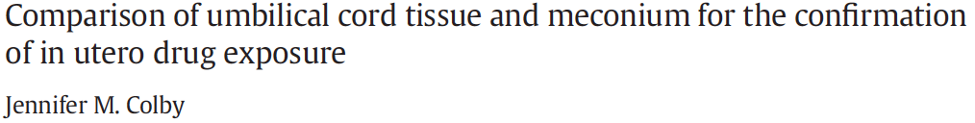
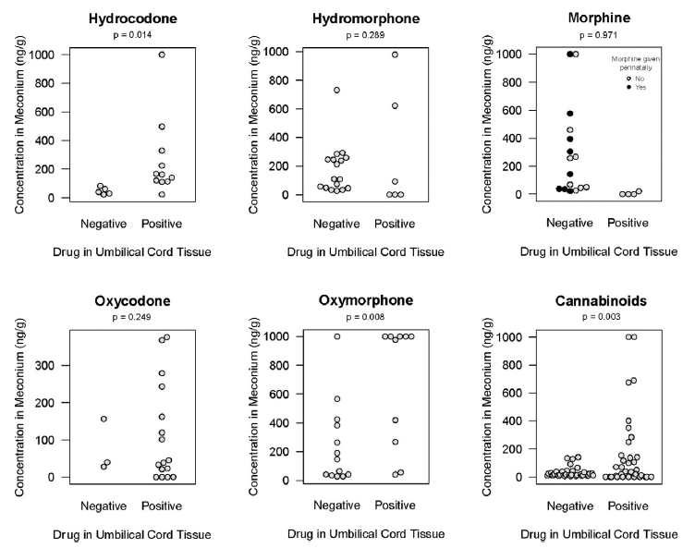
…and where you look for it

Slide 11
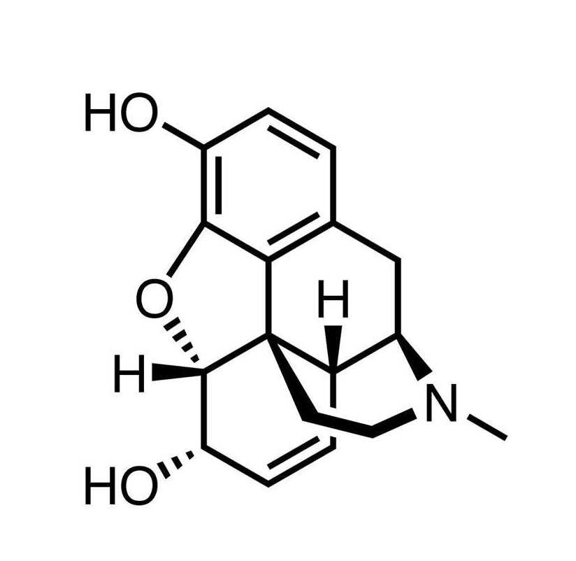
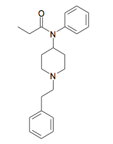
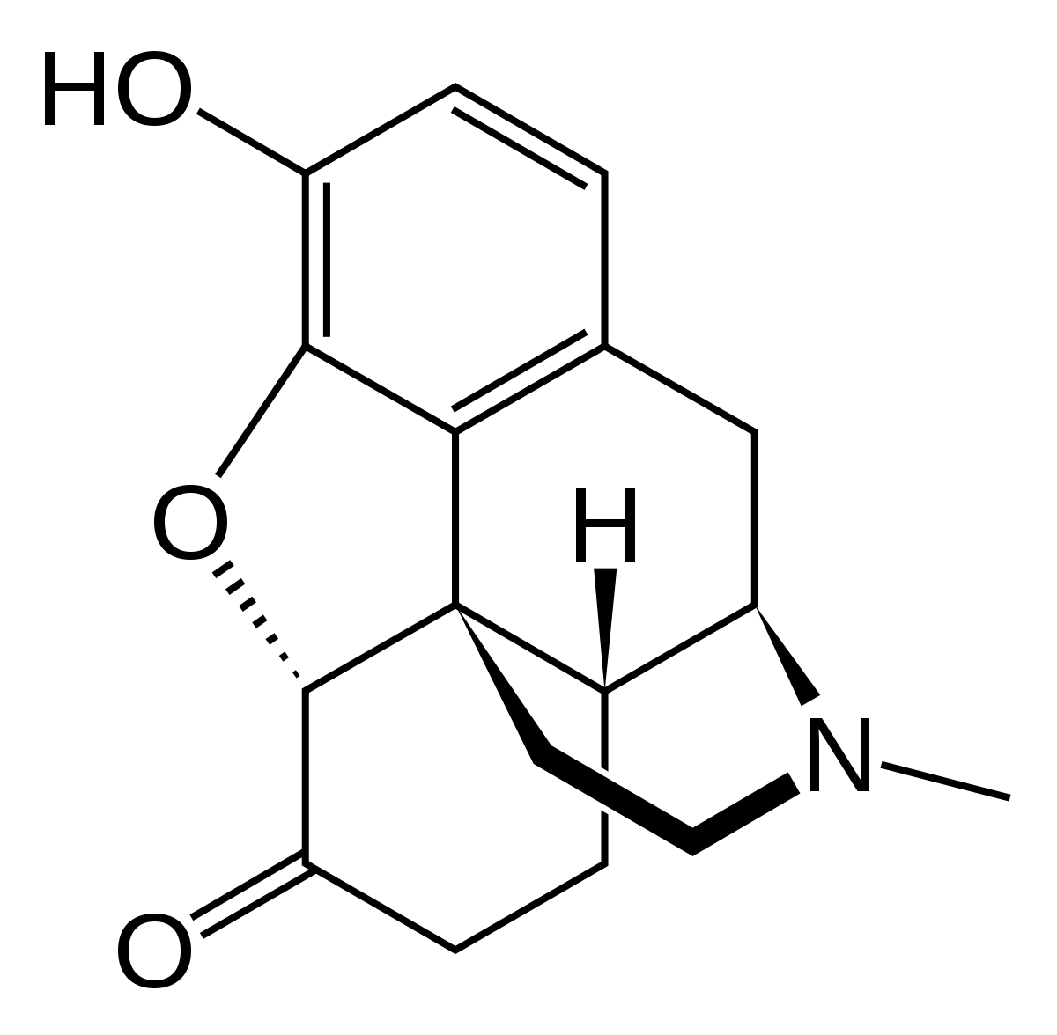
Cross Reactivity (and lack thereof)
Morphine
Hydromorphone (Dilaudid)
Fentanyl

Slide 12
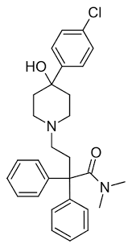
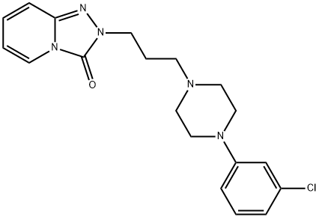
Cross Reactivity
Fentanyl
Trazodone
Loperamide

Slide 13
Documented causes of fentanyl false + UDS
Loperamide (Geno 2022)
Risperidone (Shroitman 2021)
Ziprasidone (Waters 2003)
Labetalol (Wanar 2022) **btw this pt was pregnant
Methamphetamine (Abbott 2022)
Haloperidol (Wang 2024)
Trazodone (Wang 2024)

Slide 14
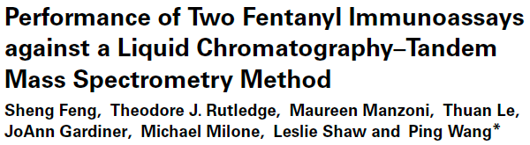
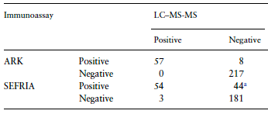

Slide 15
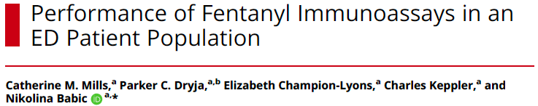
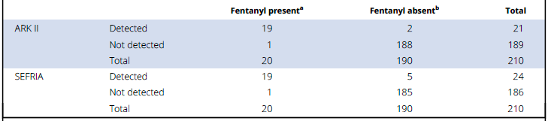

Slide 16
8/65 positives were false +
(12.3%)
2/21 positives were false +
(9.5%)

Slide 17
Common causes of false positives
Drug Classification | Potential Interference
Amphetamines | ADHD medications Decongestants Bupropion Ephedrine (Ma Huang)
Methadone | Diphenhydramine Doxylamine Vortioxetine Quetiapine
Phencyclidine | Dextromethorphan Ketamine Diphenhydramine
TCA | Diphenhydramine Quetiapine Cyclobenzaprine
***THIS IS NOT AN ALL INCLUSIVE LIST***

Slide 18
Cross reactivity across brands
Drug | Company 1 | Company 2 | Company 3
l-Amphetamine | 1 | 101 | 100
d.l-Amphetamine | 88 | 58 | 100
Methamphetamine | 100 | 100 | 100
d,l-Methamphetamine | 77 | 65 | 100
MDA | 116 | 2 | 100
MDMA | 196 | 69 | 30
Ephedrine | 1 | 1 | 50
Fenfluramine | 1 | 1 | 10
Pseudoephedrine | 1 | 1 | 100

Slide 19
DOT thresholds for positivity (aka cut offs)
Initial Test Analyte | Initial test cutoff | Confirmatory analyte | Confirmatory test cutoff concentration
Marijuana Metabolites (THCA) | 50 ng/m | THCA | 15 ng/mL
Cocaine Metabolite (Benzoylecgonine) | 150 ng/mL | Benzoylecgonine | 100 ng/mL
Phencyclidine (PCP) | 25 ng/mL | Phencyclidine (PCP) | 25 ng/mL
Amphetamine
Amphetamine | 500 ng/m | Amphetamine | 250 ng/mL
Methamphetamine | 500 ng/mL | Methamphetamine | 250 ng/mL
MDMA/MDA | 500 ng/mL | MDMA/MDA | 250 ng/mL
Opioids
Codeine/Morphine | 2000 ng/mL | Codeine/Morphine | 2000 ng/mL
6-Acetylmorphine (6AM or Heroin) | 10 ng/mL | 6-Acetylmorphine (6AM or Heroin) | 10 ng/mL
Hydrocodone | 300 ng/mL | Hydrocodone | 100 ng/mL
Hydromorphone | 300 ng/mL | Oxymorphone | 100 ng/mL
Oxymorphone | 100 ng/mL | Oxymorphone | 100 ng/mL
Oxycodone | 100 ng/mL | Oxycodone | 100 ng/mL

Slide 20
Take home point #1: toxicology testing is much more nuanced, complex, and limited than most healthcare providers appreciate

Slide 21
True or False: the prevalence of substance use during pregnancy is higher among Black individuals than among white individuals

Slide 22
False

Slide 23
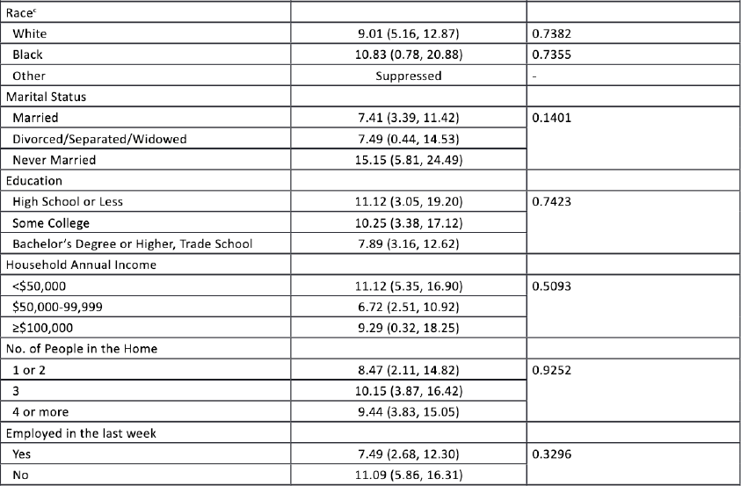
Notes:
Online anonymous survey data with methodology robust enough to generate population-level estimates on a national scale. Here, we found no difference between prevalence of last-month drug use (“any drug” means illicit drugs, NMU = non-medical prescription drug use, like taking your friend’s prescribed opioids) in white vs Black pregnant individuals between 18-49 years.

Slide 24
Notes:
We also found no difference in these other demographic factors (marital status, education level, or income).

Slide 25
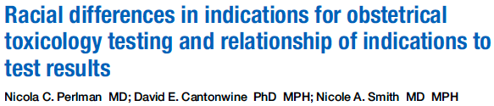
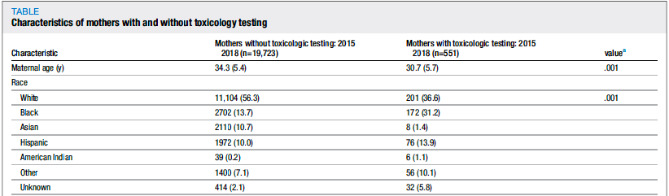
Notes:
And yet, ample data demonstrates that pregnant Black women are tox tested much more frequently than their white counterparts.

Slide 26
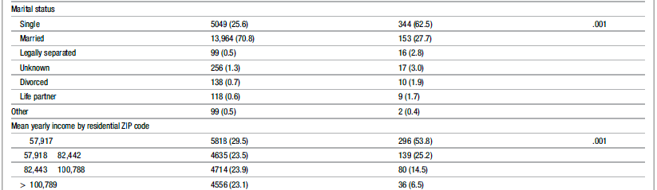
Not tested
Tested
Notes:
And also by the way, we tox test people who are single and who are poor much more often than those who are married and wealthy, even though we just saw data showing that the prevalence of drug use is not statistically significantly different among these different demographic groups. So, why do we do that – specifically with respect to race? Part of the answer has to do with what we typically think of as ”appropriate” indications for toxicology testing in the perinatal period.

Slide 27
What are common indications for sending a perinatal toxicology test at your institution?

Slide 28
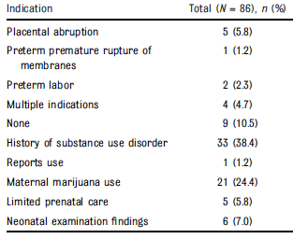
Perlman et al 2021
PMID 34373267
Notes:
Here is what the literature tells us are the common indications people are using when they send maternal/newborn tox tests

Slide 29
Perlman et al 2021
PMID 34373267
Koenigs et al 2022
PMID 35354087
Maternal indications for tox testing
Maternal complications 20%
Nonprescribed substance use excluding cannabis 23%
Maternal cannabis use 33%
Notes:
Here is another paper looking at maternal indications only, a lot of similar indications (they only listed out their top three)

Slide 30
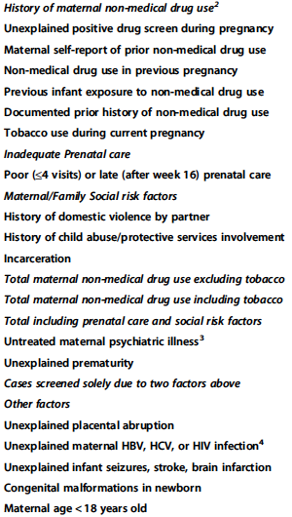
Notes:
Here is another paper looking at newborn testing, and these were their most common indications (grouped into categories). What’s the problem with these indications? First of all, a lot of these (history of CPS involvement, incarceration, premature labor and other maternal complications) occur much more often in Black pregnant individuals relative to white individuals. Also, a lot of the indications we’ve looked at so far don’t actually predict a positive tox test result!

Slide 31
Take home point #2: Black birthing parents are tox tested more often than their white counterparts, even though the prevalence of substance use during pregnancy is the same in both groups.
This is in part due to the indications used to trigger a tox test, many of which (e.g. various pregnancy complications) which occur more often in Black birthing individuals

Slide 32
Which of the following has been shown to be associated with a positive toxicology test in the medical literature?
Placental abruption
Preterm labor
Congenital malformations in a newborn
Intrauterine growth restriction
Tobacco use during pregnancy
All of the above

Slide 33
Which of the following has been shown to be associated with a positive toxicology test in the medical literature?
Placental abruption
Preterm labor
Congenital malformations in a newborn
Intrauterine growth restriction
Tobacco use during pregnancy
All of the above

Slide 34

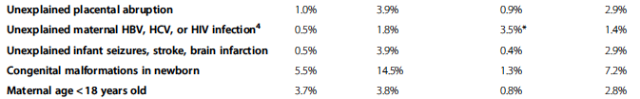
Notes:
So not only are the indications we use to test people inherently going to lead us to test more Black individuals, they don’t even lead us to positive tests in the first place

Slide 36
Take home point #3: Many commonly used indications for tox testing are not, in fact, more likely to identify birthing parents with positive tox tests

Slide 37
Take home point #3: Many commonly used indications for tox testing are not, in fact, more likely to identify birthing parents with positive tox tests
Incidentally, many of these indications overlap with those that occur more often in non-white (especially Black) patients.
The indication that most reliably predicts a positive tox test result is a known history of substance use during pregnancy.

Slide 38

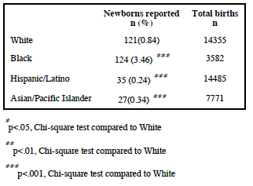
Notes:
So why is it bad that we are testing Black birthing people and Black babies more often than white ones? Because it leads to overreporting.

Slide 39
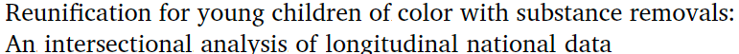
PMID 32799013
0-4 years | Adjusted HR | 95% CI | P-value
SUD POC | REF | REF
SUD White | 1.13 | (1.02, 1.24) | <0.05
No SUD POC | 1.62 | (1.46, 1.80) | <0.001
No SUD White | 1.47 | (1.33, 1.62) | <0.001
Notes:
Relative to young children of color removed with a substance use concern, every other group of children (white, or no substance use concern, or older kids) was more likely to achieve reunitfication

Slide 40
In summary: tox testing can be harmful
Inappropriate interpretation
Racial/ethnic disparities in toxicology testing and in child welfare reporting specifically related to substance use
Damage to the therapeutic alliance during this and future healthcare encounters

Slide 41
But also: tox testing can be beneficial
Diagnostic tool to guide medical management
Demonstrate abstinence or compliance with therapy
Help inform safety of breastmilk use

Slide 42

Then when am I supposed to test?!?!

Slide 43
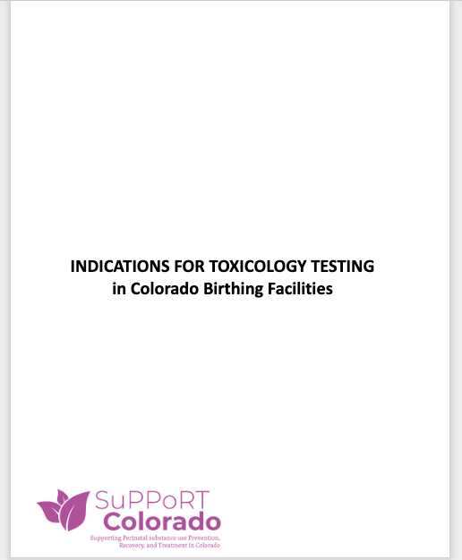
https://illuminatecolorado.org/supportcolorado/
Scroll down to where it says “Resources” (about 2/3 down the page)
Click “Toxicology Testing Resources” (or keep scrolling down and you’ll get to the same place)

Slide 44
Indications for tox testing: birthing parent
1) Signs and symptoms of intoxication, withdrawal, or altered mental status
2) If desired by the birthing person
3) Birthing person desires to chest/breastfeed, AND one or more of the following conditions exist:
Report of substance use or positive urine toxicology test during last trimester of pregnancy.
Birthing person has an active substance use disorder and is not engaged in treatment.
Note: If birthing person is involved in treatment, it is strongly recommended to consult with providers who have an ongoing relationship with the birthing person to assess the level of engagement with recovery

Slide 45
Indications for tox testing: newborn
1) Newborn exhibits symptoms consistent with intoxication or withdrawal
2) Newborn’s birthing parent meets criteria for toxicology testing, AND results would alter medical management of the newborn
3) Newborn with physical stigmata of FASD*

Slide 46

Tox test result comes back…

Slide 47
Informed consent
Opportunity to build/enhance the therapeutic alliance
Necessary before testing a birthing person unless the patient lacks capacity
Best practice in most cases of newborn testing. If consent is not obtained, testing should only be sent if there is a compelling medical need

Slide 48
Common concerns
If I ask for consent, the parent will refuse
If I don’t test someone/everyone, I might miss covert substance use
If I miss covert substance use, the baby will be in danger (and if something happens, it will be my fault)
Isn’t it safest/best to just test/remove baby until we know for SURE that the household is safe?

Slide 49
In summary
Tox testing is complicated
Tox testing can be harmful and can be beneficial
If you order a tox test, you should be able to articulate precisely how the results will change your clinical management and get consent first
If you have concerns about an infant or child’s safety, you should make a report to child welfare, regardless of whether tox testing is planned or has been performed (and regardless of the results, if performed)

Slide 50
Thank you!
Questions? Comments? Rude remarks?
Email me! Laurie.halmo@childrenscolorado.org
References included throughout, but I can email you a list if you’d like

