Slide 1
Milestone 5 Examples
Please consider these as ideas, not constraints – if you have another idea for milestone 5 and need guidance, please reach out to your QI coach for clarification.

Slide 2
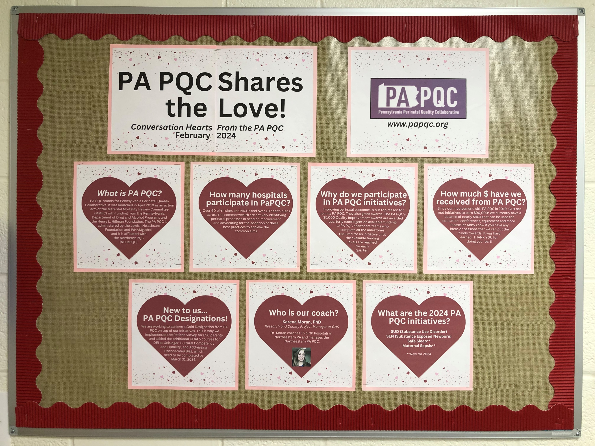
Photos of Huddle Boards, reporting out recent work and data.
Notes:
Geisinger Lewiston Huddle Board

Slide 3
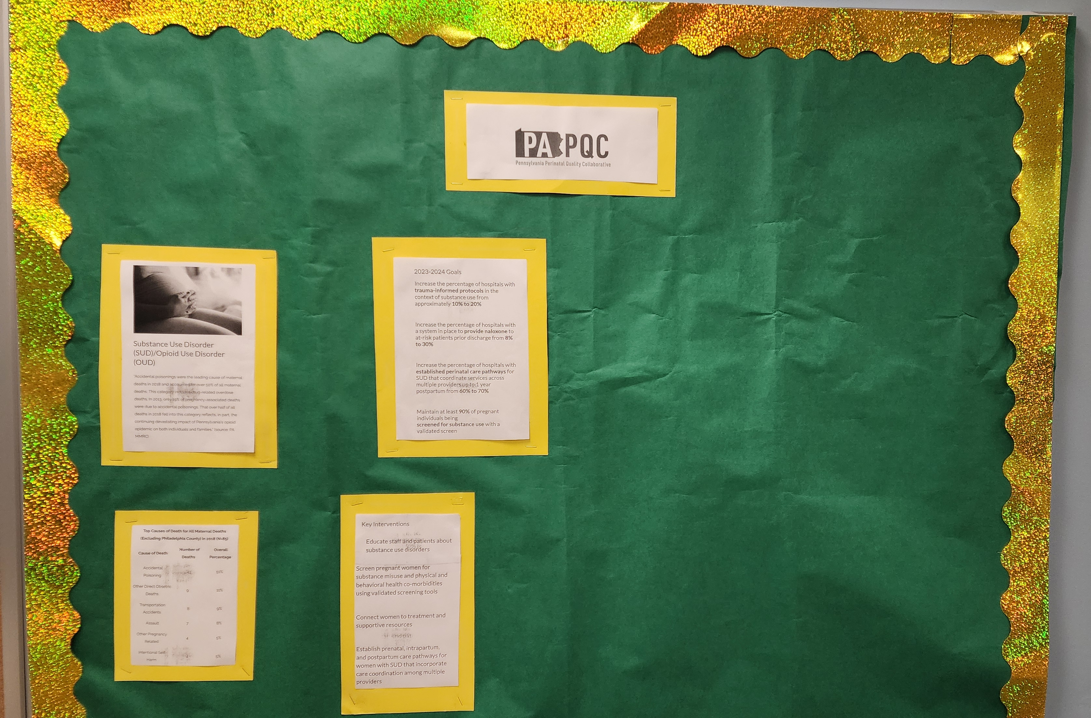
This team created a board that outlines their hospital’s involvement with the PA PQC Maternal Opioid Use initiative. It is located in the maternity break room. Highly visible in the middle of the main wall. It explains Maternal Opioid Use Initiative, the goals, and the key interventions. As education is created, it will be posted on this board. The board is easy to access, read, and very informative for staff.
Notes:
The team also created a billboard that outlines Grand View hospital’s involvement with the PAPQC Maternal Opioid Use initiative. It is located in the maternity break room. Highly visible in the middle of the main wall. It explains Maternal Opioid Use Initiative, the goals, and the key interventions. As education is created it will also be posted on this billboard. This billboard is easy to access, read, and very informative for staff.

Slide 4
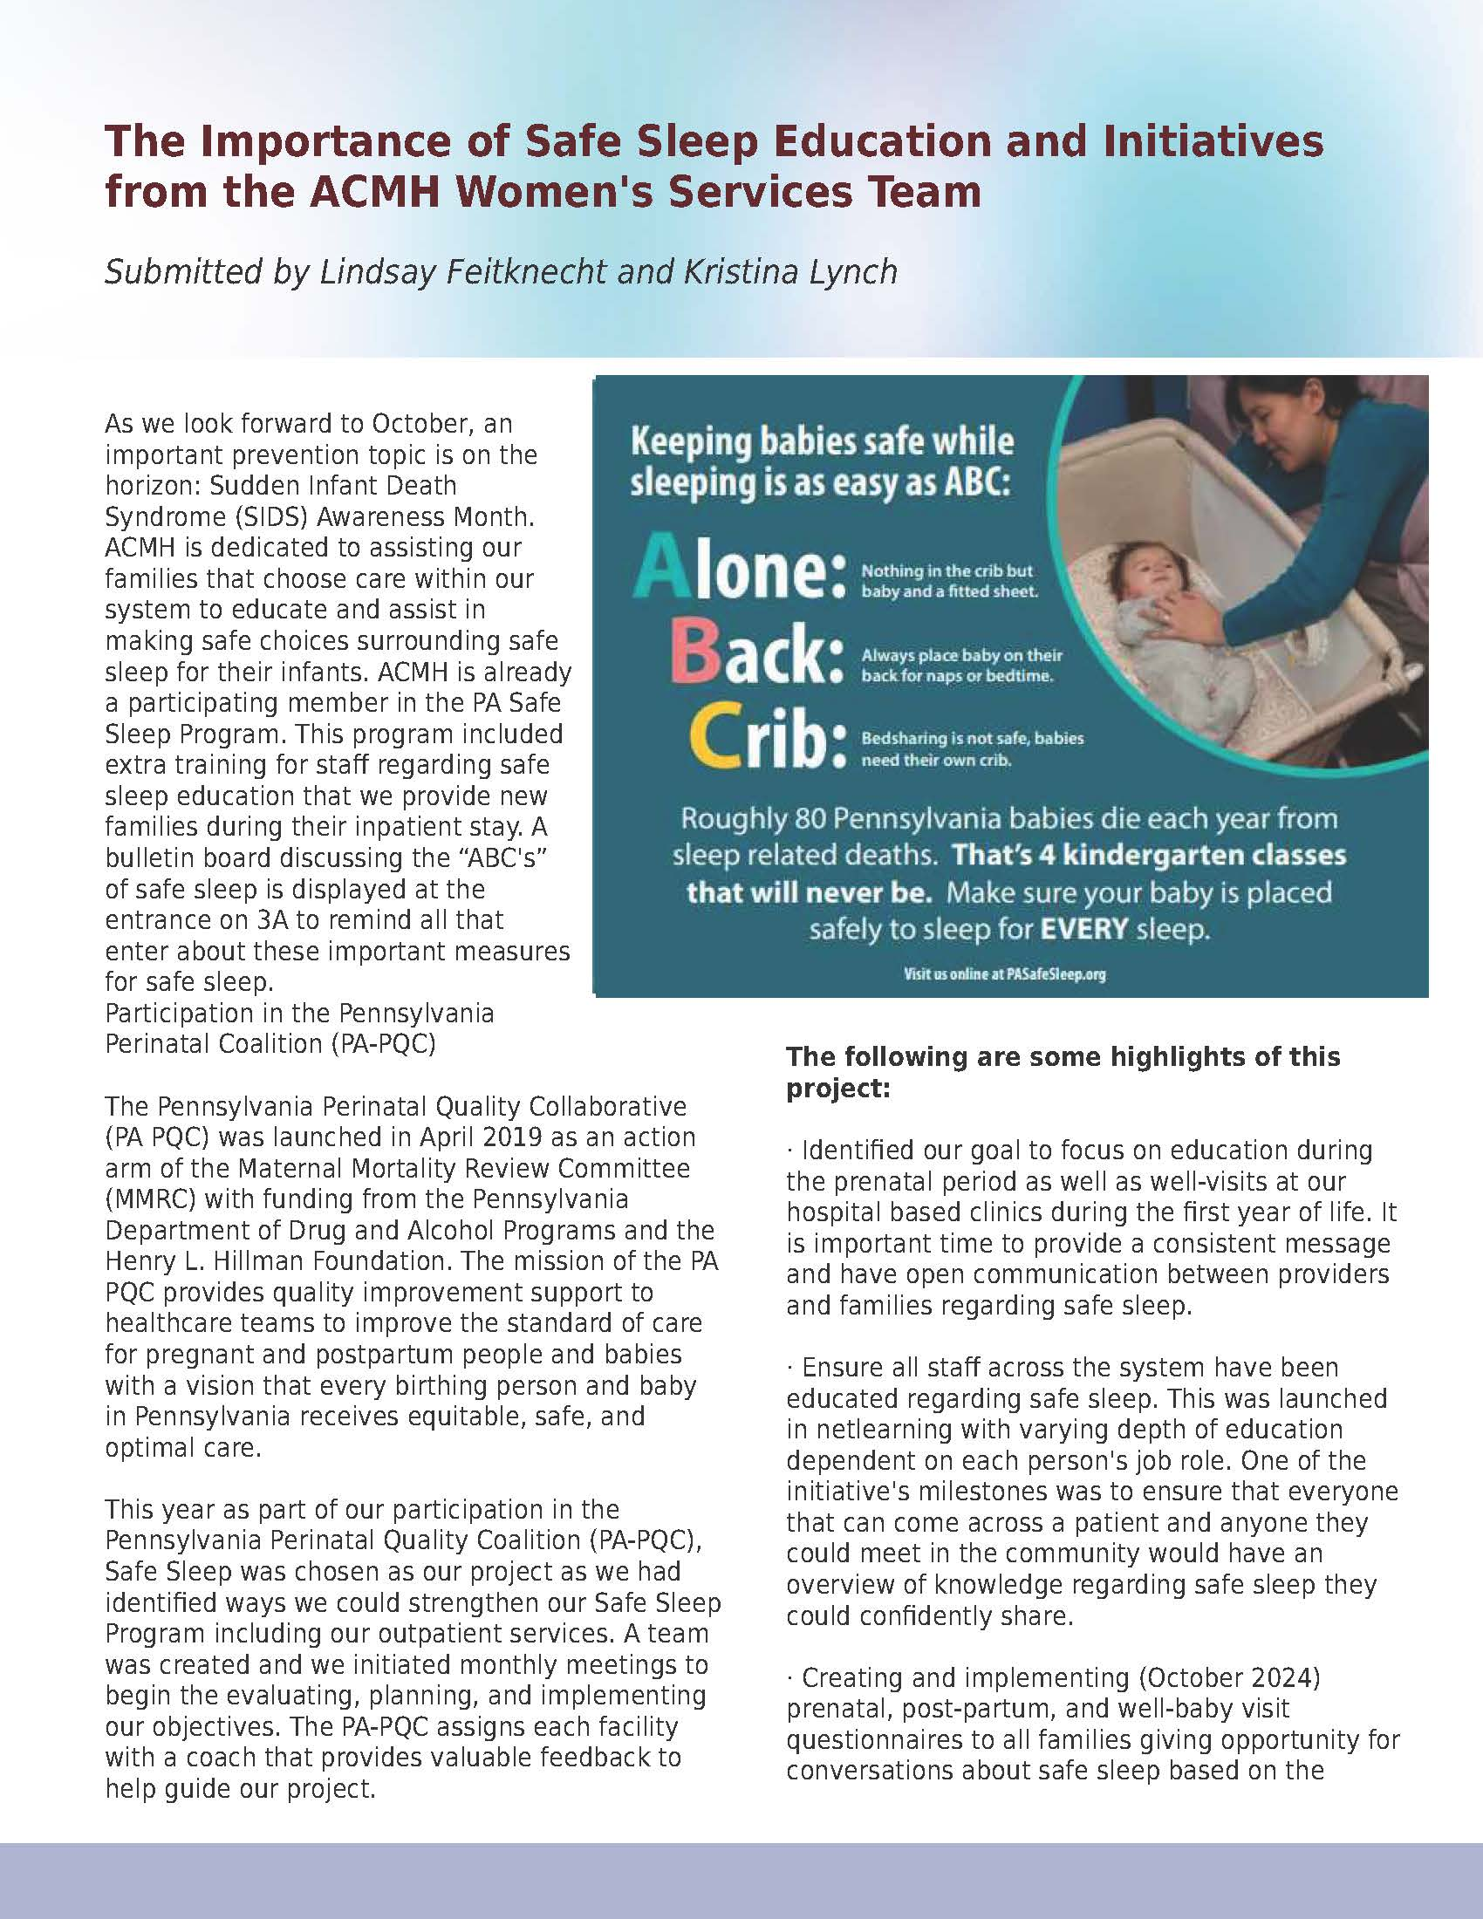
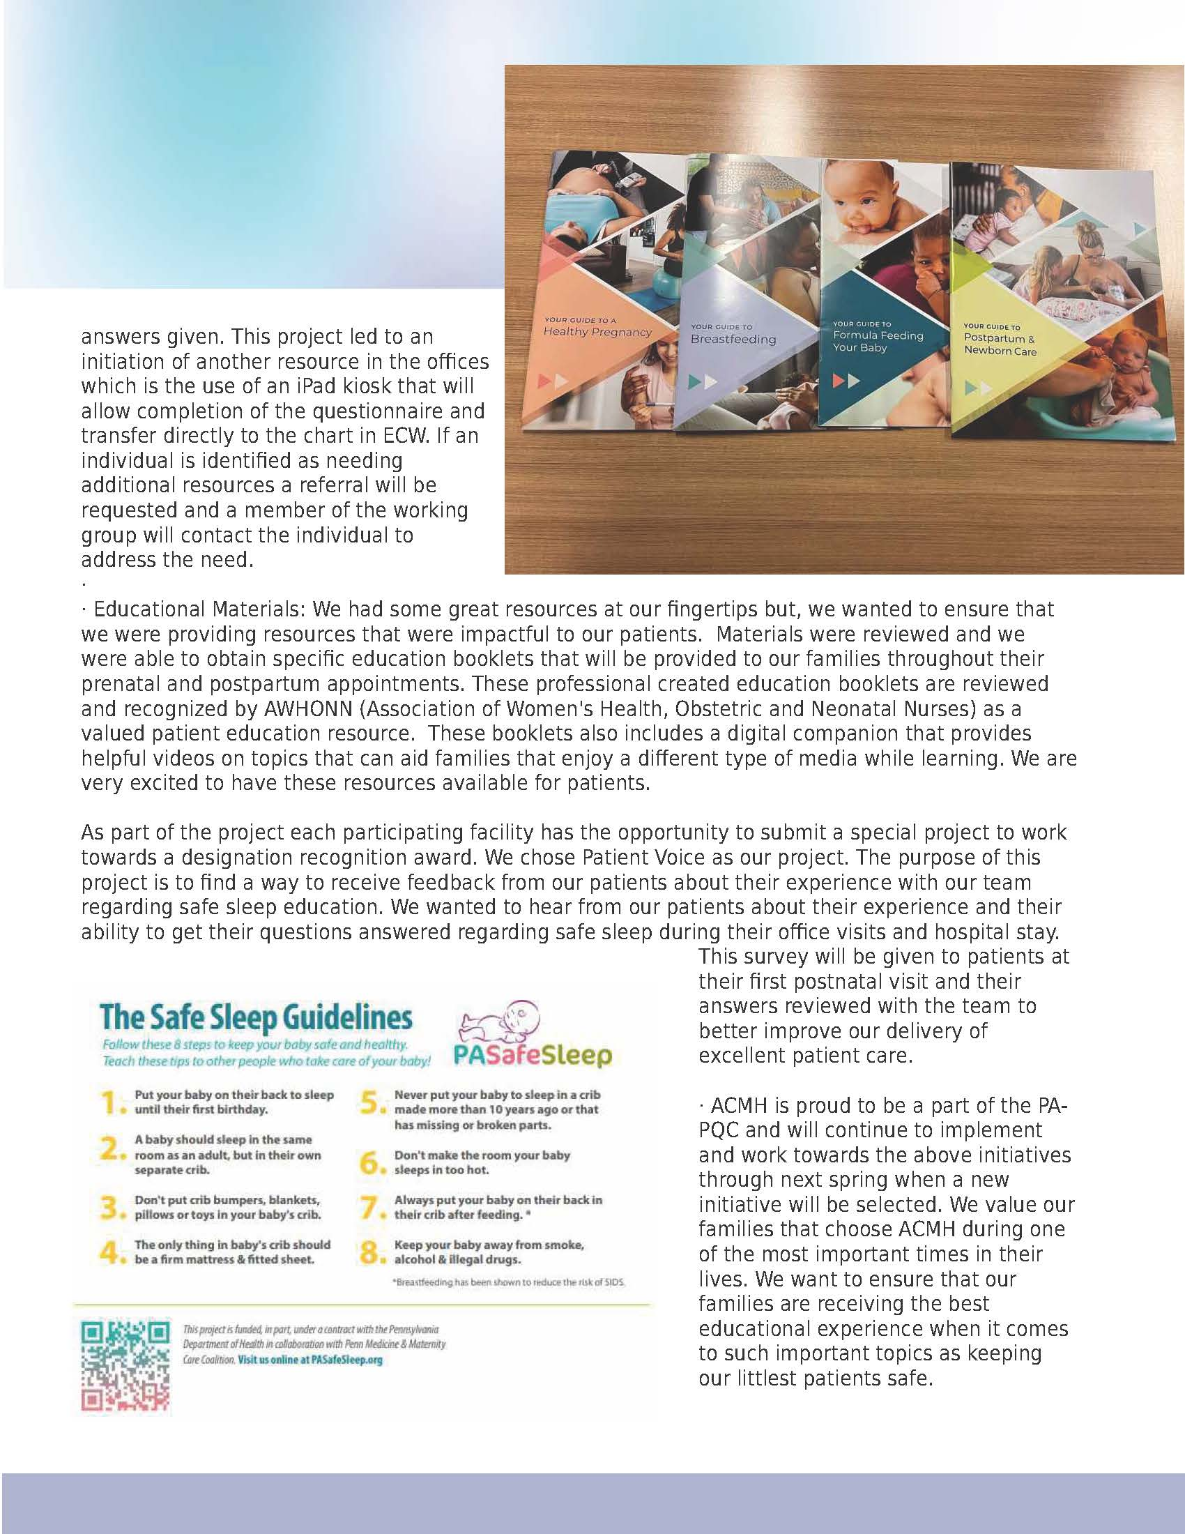
This site wrote about their participation in the initiative in a newsletter, then added in education as well!

Slide 5
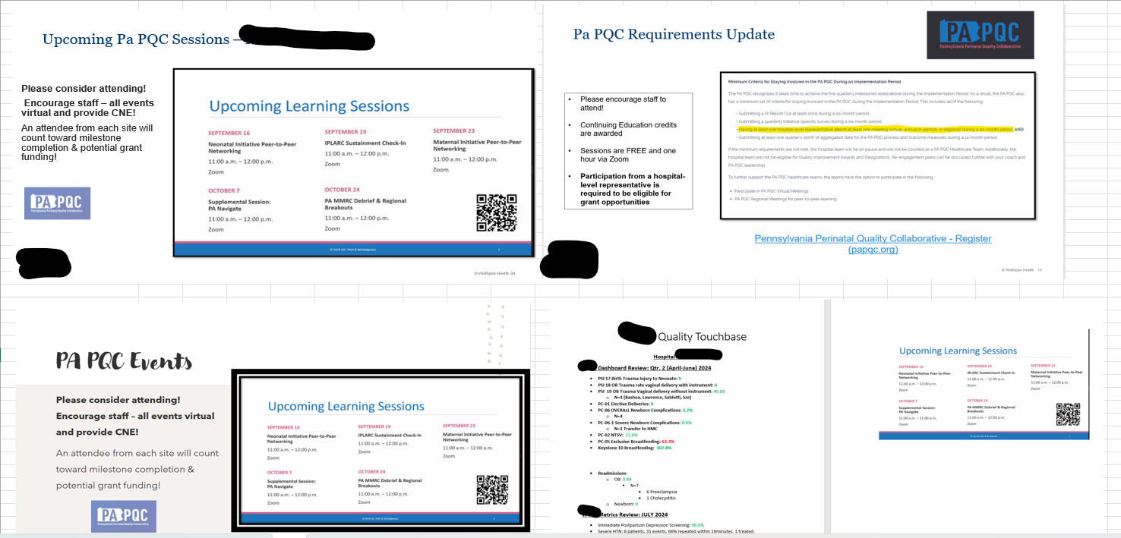
This is a great example for teams that work as a system with a single person reporting milestone 5 to the QI Coach.
In an excel, there is a separate tab for each participating hospital within that system where screenshots of staff communications about PA PQC are placed to show how the team is communicating out about their work.
This takes away the need to send individual emails for milestone 5 for each hospital in the system.
Notes:
Kristen’s site – sends screenshots of what is sent to staff each month and puts them in an excel to make it easy to send as a single document to the QI coach
Excellent job encouraging staff to attend virtual sessions! We love having new attendees and spreading the content to as many folks across the state as possible!

Slide 6
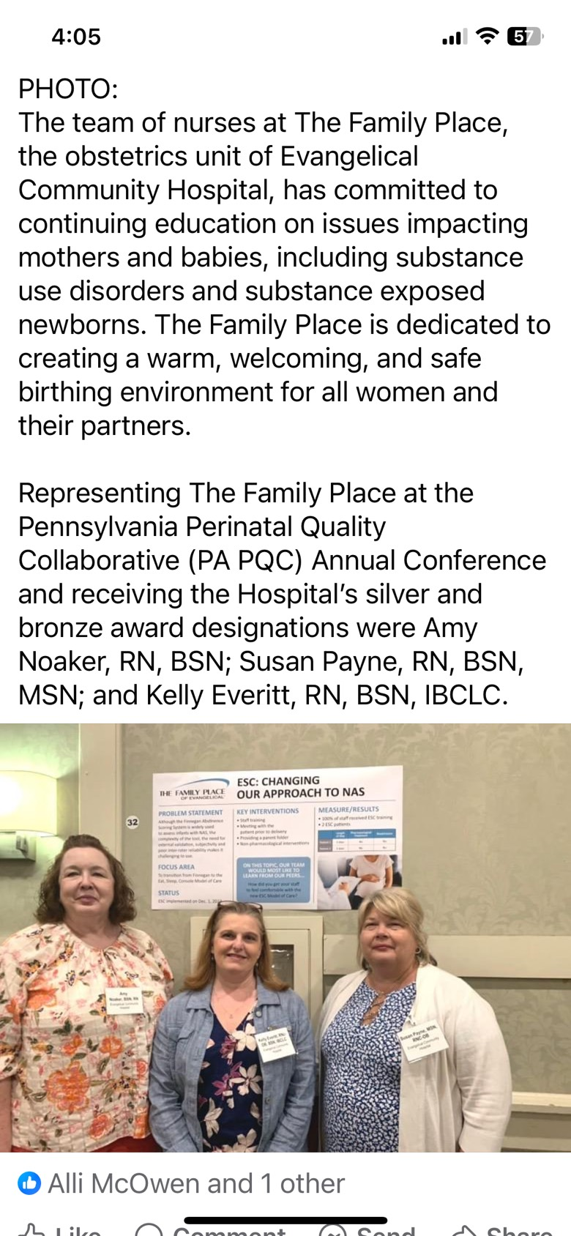
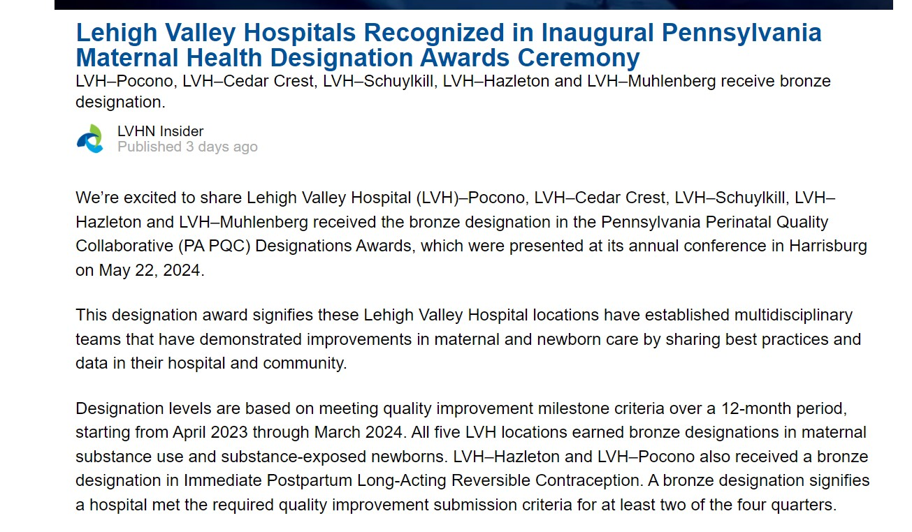
Sharing out to your community counts for milestone 5 as well! Social Media posts or press releases can be used for milestone 5.
Notes:
Evangelical Social Media

